Slide 1

Explainable Model for Orchestrating ML-based Security Services in Digital Twin
Minh Tri Nguyen
PhD student at Department of Computer Science, Aalto University

Slide 2
Outline
Motivation
Security Orchestration and Automated Response (SOAR)
Research Goal
Approach
Early Results
Some

Slide 3

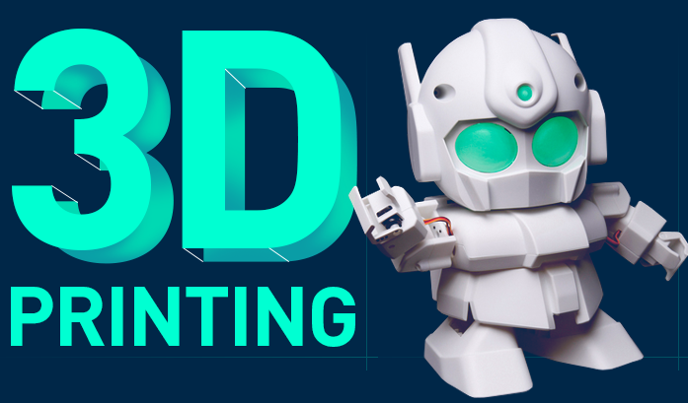
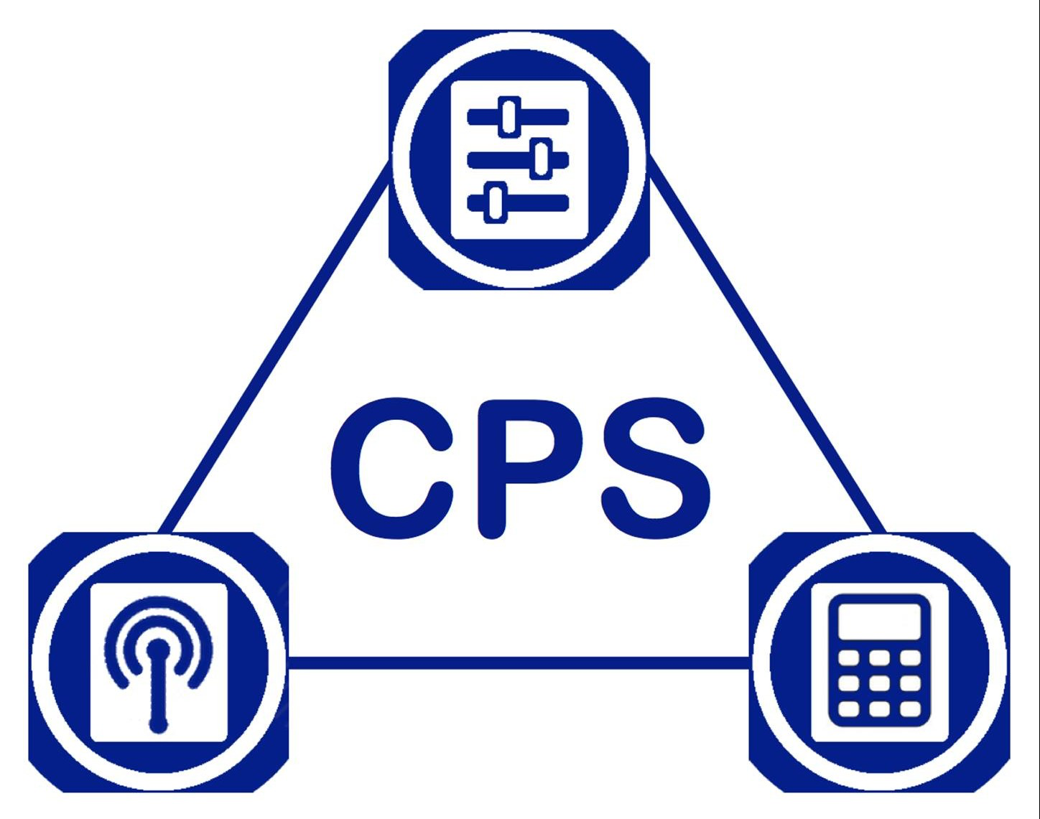
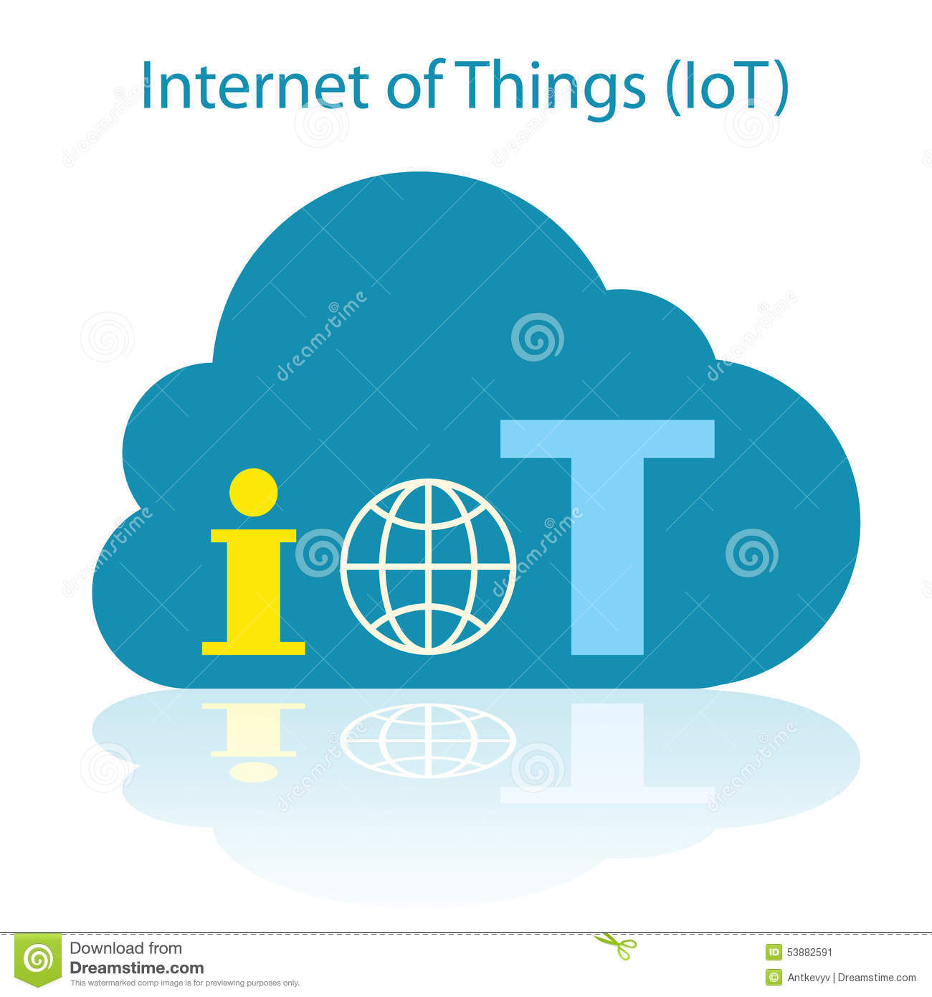

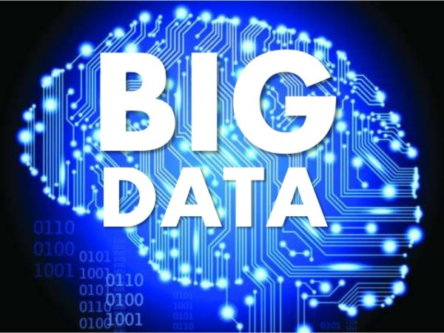

Industry 4.0 = new ways in which technology becomes embedded…
CPS: Cyber-Physical Systems
IoT: Internet of Things
… within societies and even the human body.

Slide 4


CPS/IoT are powering the world and having huge impact on us
How can we protect CPS/IoT-based critical systems?

Slide 5
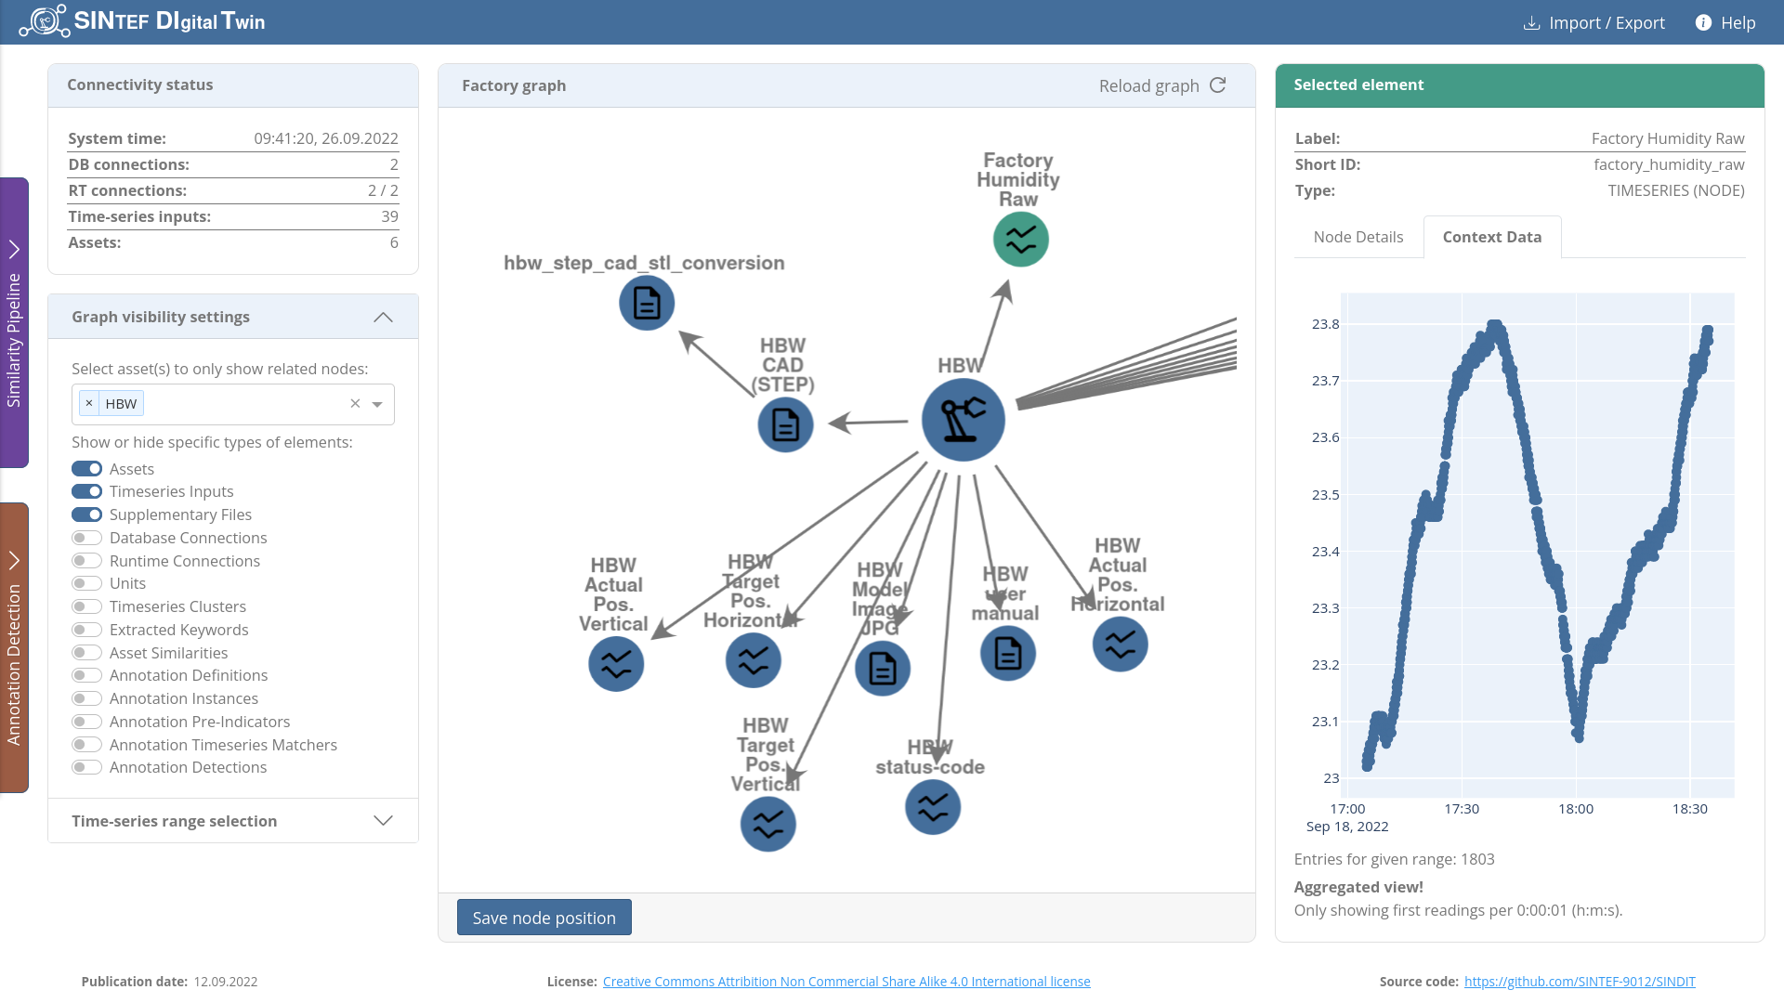
Digital Twins (DTs)
https://github.com/SINTEF-9012/SINDIT
There is a big growth in using DTs to monitor and optimize systems in the digital society, e.g., in Industry 4.0 (SINDIT example)
How can we protect DTs-CPS/IoT-based systems?

Slide 6
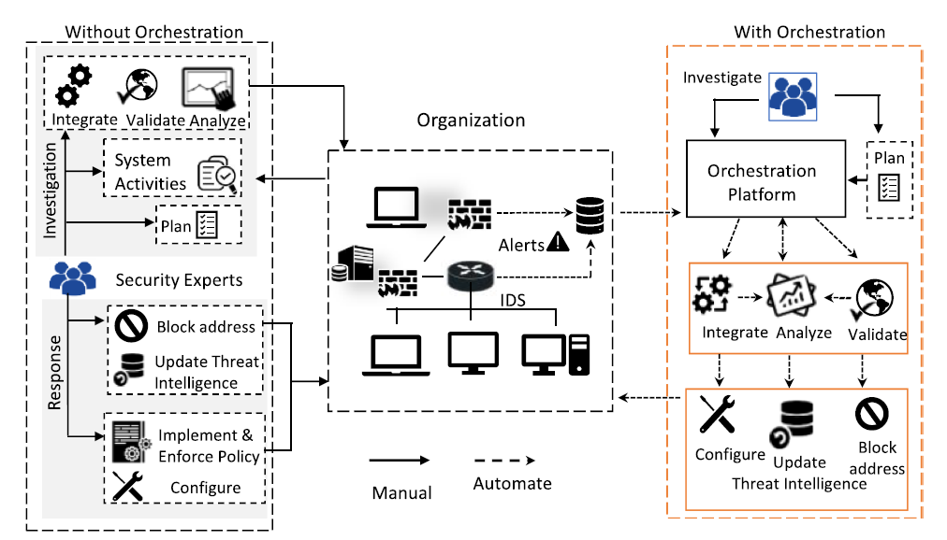
Security Orchestration and Automated Response (SOAR)
SOAR “is the planning, integration, cooperation, and coordination of the activities of security tools and experts to produce and automate required actions in response to any security incident across multiple technology paradigms”
Islam, Chadni, Muhammad Ali Babar, and Surya Nepal. "A multi-vocal review of security orchestration." ACM Computing Surveys (CSUR) 52.2 (2019): 1-45.
Notes:
A concrete example: Imagine that a hacker attacks the CI and how the CI Operator could protect
Remember the punchline: This could help security response to be timely. To make the job easier.

Slide 7











Security in Digital Twins
The emergence of Digital Twins for monitoring and optimizing systems in the Industrial IoT environment (IIoT) raise enormous security concerns.
Challenges:
Security Orchestration Automation & Response (SOAR):
Complex Physical systems
Trust issue when adopting ML-based solutions to reduce human effort
Multi-vendor security tools/frameworks:
Data formats/structures
Configuration
Digital Twin
Physical Entities

Slide 8
Research Goals
Building an Explainable Model for Orchestrating Security Services:
Supporting Security Tool Unification
Facilitating Security Playbook Development
Improving Explainablity in SOAR for ML-base Security Services

Slide 9
Approach
Modeling Security System:
Security Report & Security Plan:
Abstracting the security report/plan for different security tools in understandable format with sufficient information
Improve end-to-end explainability and performance evaluation
Cyber Threat Intelligence:
Storing security events, security plan as knowledge graph
Supporting SOAR in reasoning security plan and applying ML for continuous learning
Integrating with Digital Twin’s knowledge graph
Applying security plan to complex physical system

Slide 10
Application Scenario
Monitoring Toy Factory with SINDIT
Simulating data transferring among components within an SDN networks
Simulating DDoS attacks and data tampering
Deploying 2 ML-based Security services for detecting attacks
Reasoning security plan and attacked locations (affected components)
Automating network Firewall configuration to prevent the attacks

Slide 11


Application Scenario
Security Plan
CTI (Playbook)
SINDIT
Knowledge Graph
SOAR
Security Report
Threat Detection Tools
Configuration Tools
Security Tools
MQTT Gateway
Firewall Config
OPC-UA Gateway
SDN
Controller
Sensor data
Tampered
Sensor data
MPO
MPO
SLD
DPS
SSC
VGR
HBW

Slide 12
Application Scenario
Security Plan
CTI (Playbook)
SINDIT
Knowledge Graph
SOAR
Security Report
Threat Detection Tools
Configuration Tools
Security Tools
MQTT Gateway
Firewall Config
OPC-UA Gateway
SDN
Controller
Sensor data
DdoS Attack
MPO
MPO
SLD
DPS
SSC
VGR
HBW

Slide 13
Thank you!
Any Question?
Notes:
Thank you and now is time for question

